Slide 1
DEVELOPMENT AND VALIDATION OF ROBUST RP-HPLC METHOD FOR QUANTITATIVE ANALYSIS OF TEPOTINIB IN PHARMACEUTICAL FORMULATIONS: A QUALITY BY DESIGN APPROACH
Dissertation submitted to
THE TAMIL NADU DR. M.G.R. MEDICAL UNIVERSITY,
CHENNAI - 600 032
In partial fulfilment of the award of the degree of
BACHELOR OF PHARMACY
IN
PHARMACEUTICAL ANALYSIS
Under the Guidance of Dr. D.KAMALAKANNAN, M.Pharm., Ph.D.,
PROFESSOR AND HEAD, DEPARTMENT OF PHARMACEUTICAL
ANALYSIS,
EXCEL COLLEGE OF PHARMACY
Submitted by
DHINESH KUMAR .C
GOKUL .S
RAMANA .R
SENTHIL RAJ. M.G
SRIKANTH . A

Slide 2
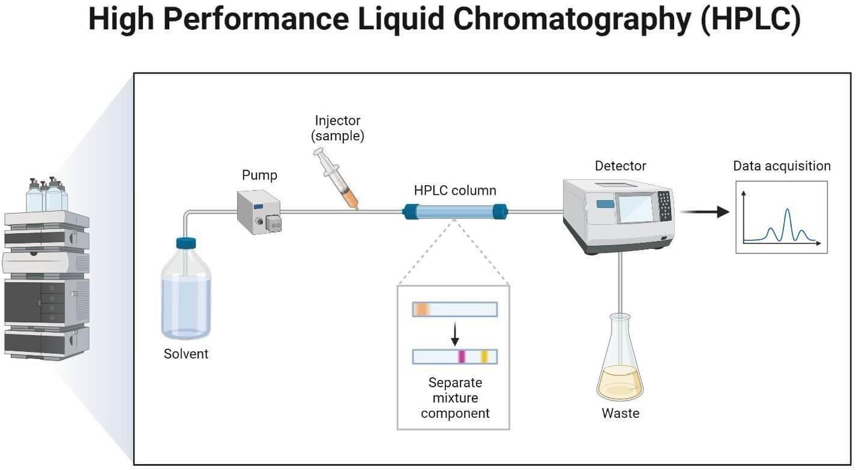
INTRODUCTION
High Performance Liquid Chromatography
"Chromatography" is a technique for separation of mixture of compounds into individual components by using mobile and stationary phase. “Chromatogram" is the result of chromatography, and "chromatograph" is the instrument used to conduct chromatography.
Only compounds dissolved in solvents can be analyzed with HPLC. HPLC separates compounds dissolved in a liquid sample and allows qualitative and quantitative analysis of what components and how much of each component are contained in the sample.

Slide 3
AIM AND OBJECTIVES
AIM
The aim of this research work is to develop a novel, accurate, precise, cost-effective analytical method by using RP-HPLC method, for the selected Anti-cancer drugs (TEPOTINIB).
OBJECTIVES
To develop a new analytical method for the estimation of TEPOTINIB in pharmaceutical dosage form using quality by design (QBD) approach.
To perform a validation for the developed method using various parameters as per ICH guidelines.
To develop a stability indicating assay method (SIAM) for Tepotinib by QbD approach
Conduction of forced degradation studies under different stress condition as per ICH guidelines

Slide 4
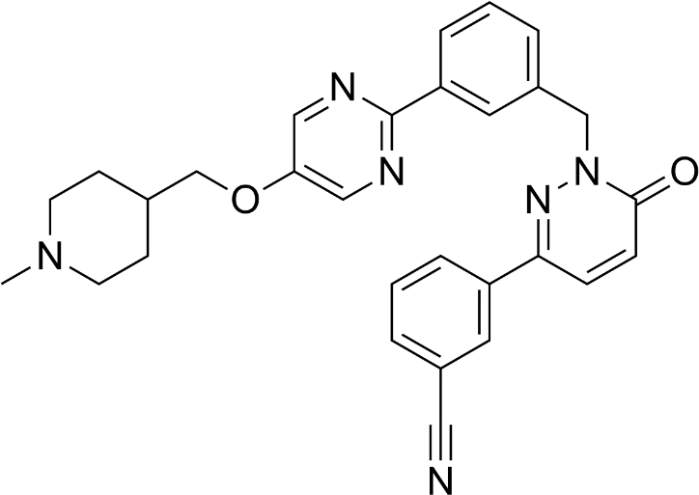
DRUG PROFILE
TEPOTINIB
IUPAC name : 3-{1-[(3-{5-[(1-methylpiperidin- 4-yl) methoxy] pyrimidin2-yl} phenyl) methyl]-6- oxo-1,6- dihydropyridazin3-yl}benzonitrile
Molecular formula :C29H28N6O2
Molecular weight : 492.583 g/mol⁻¹
Appearance : Film coated tablets
Boiling point: 626.5±65.0℃ at 760 mmHg
Solubility: slightly soluble at pH 4.5 and practically insoluble at pH 1.2and7.4).
Bioavailability: 72%

Slide 5
MATERIALS AND METHODS
MATERIALS
Tepotinib pure drug (API), Tepotinib formulation (Tepmetko), Distilled water, Acetonitrile, Phosphate buffer, Methanol, Potassium dihydrogen ortho phosphate buffer, Ortho-phosphoric acid. All the above chemicals and solvents are from Rankem.
INSTRUMENTS
WATERS HPLC 2695 SYSTEM equipped with quaternary pumps
Photo Diode Array detector and Auto sampler integrated with Empower 2 Software.
UV-VIS spectrophotometer PG Instruments T60 with special bandwidth of 2mm and 10mm and matched quartz cells integrated with UV win 6 Software was used for measuring absorbance of Tepotinib solution.

Slide 6
LITRATURE REVIEW
J. Nikhil et al., (2022) established a highly precise RP-HPLC method for the estimation of Tepotinib, utilizing an Ascentis column (150 mm × 4.6 mm, particle size 2.7 µm). The chromatographic analysis employed a mobile phase composed of a 50:50 mixture of acetonitrile and 0.1% OPA, flowing at a rate of 1 mL/min. Method optimization ensured accuracy, evidenced by intermediate accuracy values of 0.9 and 1.2 during the validation process. Detection was accomplished at a wavelength of 310 nm, with the column temperature consistently maintained at 30°C. The mobile phase served as the diluent for the analysis, streamlining the procedure. Limits of quantification (LOQ) and detection (LOD) for Tepotinib were established at 0.85 g/mL and 0.28 g/mL, respectively.

Slide 7
M.M. Shirawar et al., (2023) developed of a stability-indicating high-performance liquid chromatography (HPLC) method for the precise quantification of tepotinib in both bulk and pharmaceutical formulations, aligning with established ICH (International Council for Harmonization) guidelines. the study employed a Phenomenox Kinetex XB- C₁₈column (150×4.6 mm, particle size 5µ) for successful separation. The constant flow rate of 1 mL/min and absorbance measurements at 272 nm ensured method reliability. Systematic evaluations, following ICH guidelines, encompassed linearity, precision, accuracy, system suitability, specificity, and robustness. Results revealed a Tepotinib retention time of approximately 3.4 minutes, exhibiting excellent linearity in the 5-25 μg/mL concentration range (correlation coefficient, r² ≈ 0.9993). High accuracy and precision were demonstrated, with %Relative Standard Deviation values are below 2%. The method's sensitivity was underscored by LOD and LOQ values of 0.429 µg/mL and 1.3 µg/mL, respectively

Slide 8
QUALITY BY DESIGN
DEFINITION
Pharmaceutical QbD is a systematic approach to development that begins with predefined objectives and emphasizes product and process understanding and control based on sound science and quality risk management.
PRINCIPLE OF QBD
The basic principle of QbD is that quality cannot be tested into products, but that quality should be built in by design.
Therefore, QbD aims to ensure the desired quality of the product by assessing the variables which might impact the quality.
OBJECTIVES OF QBD
To achieve meaningful product quality specifications that are based on clinical performance
To increase product development and manufacturing efficiencies
To enhance root cause analysis and post approval change management.

Slide 9
Design summary of CCD
Design Summary
File version : DX 11.0.0 Study Type : Response surface Design Type : Central Composite Design Design Model : Quadratic |  |  | ATP : Robustness CQA : Retention time, Area, Theoretical plates and Asymmetry Runs : 24
CMPs | Unit | Type | Subtype |  | Max.
Column temperature | 0C | Numeric | Continuous | 26.64 | 33.36
Flow rate | mL/min | Numeric | Continuous | 0.6636 | 1.34
%Org ratio | % | Numeric | Continuous | 36.59 | 53.41

Slide 10
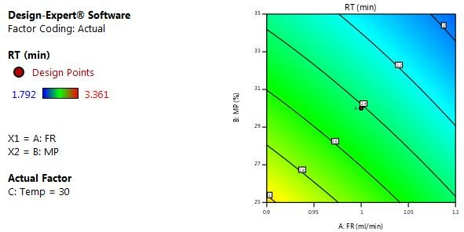
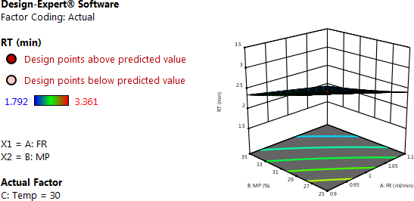
2D Contour plots of retention time
3D Contour plots of retention time

Slide 11
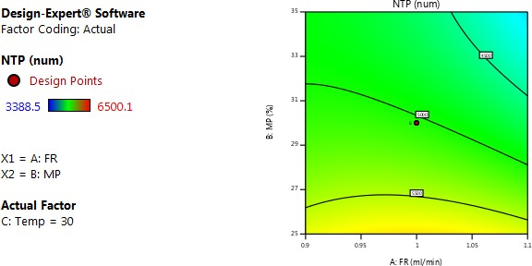
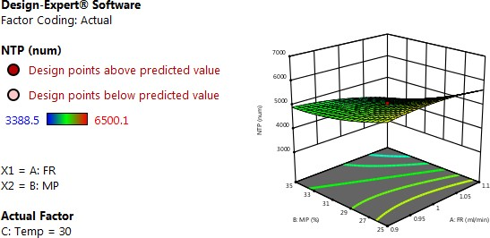
2D Contour plots of theoretical plates
3D Contour plots of theoretical plates

Slide 12
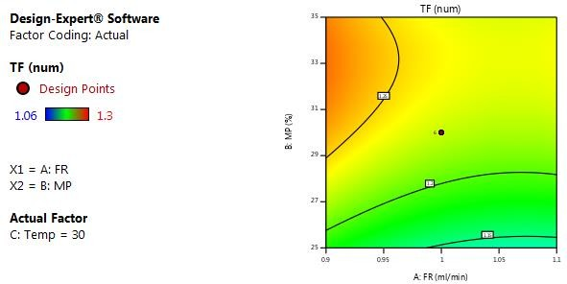
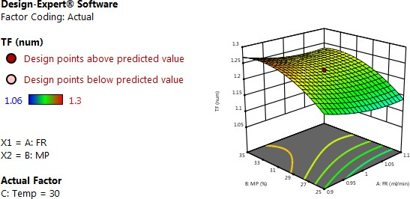
2D Contour plots of asymmetry
3D Contour plots of asymmetry

Slide 13
VALIDATION PARAMETERS
Specificity
Linearity
Precision
Accuracy
Sensitivity
Robustness
FORCED DEGRADATION STUDIES
Acid
Base
Peroxide
Thermal
UV
Water

Slide 14
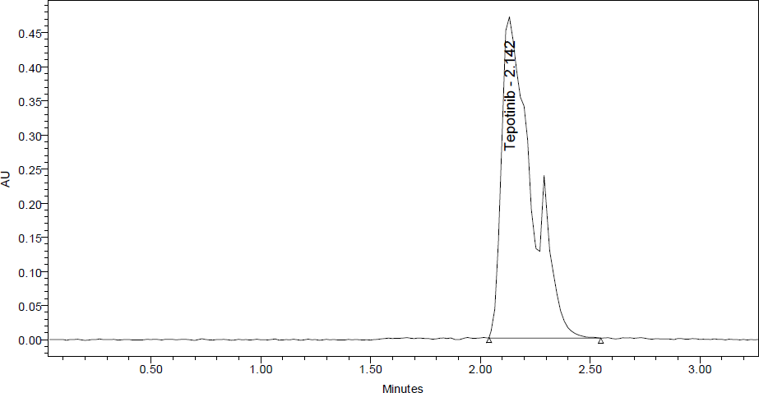
CHROMATOGRAPHIC CONDITIONS
Trial 1:
Mobile phase : Acetonitrile; Water (50:50)
Flow rate : 1.0 mL/min
Column used : Kromosil C₁₈ 250mm x 4.6mm, 5µ
Injection vol : 10 µL
Observation: In this trail peak shape was not good & tailing was observed so further trial was carried out.

Slide 15
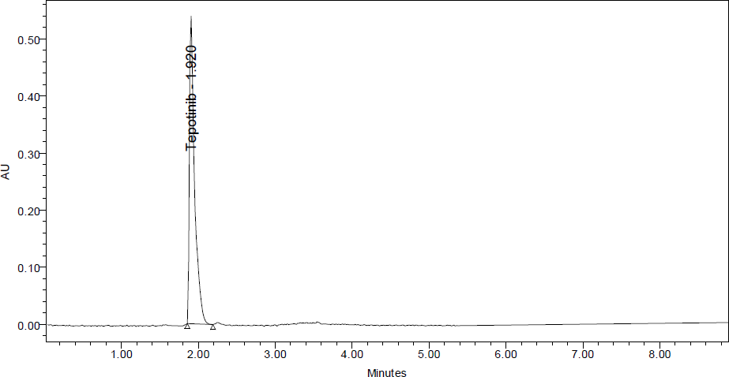
Trial 2:
Mobile phase : Methanol;Water (60:40)
Flow rate : 1.0 mL/min
Column used : Kromosil C₁₈ 250mm x 4.6mm, 5µ
Injection vol : 10 µL
Observation: In this trail peak shape was not good, so further trial was carried out.

Slide 16
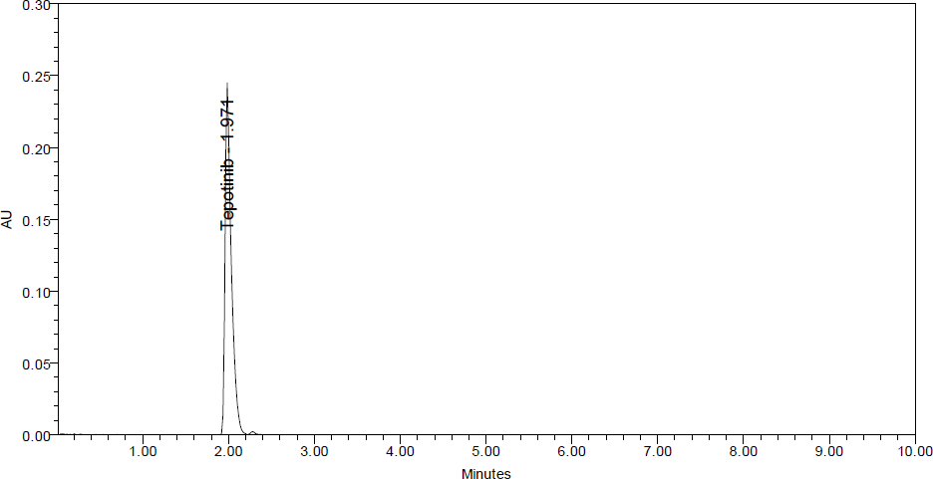
Trial 3:
Mobile phase : Methanol ; Kh2 (70:30)
Flow rate : 1.0 mL/min
Column used : Kromosil C₁₈ 250mm x 4.6mm, 5µ
Injection vol : 10 µL
Observation: In this trail retention time observed, but peak splitting is observed. so further trial was carried out.

Slide 17
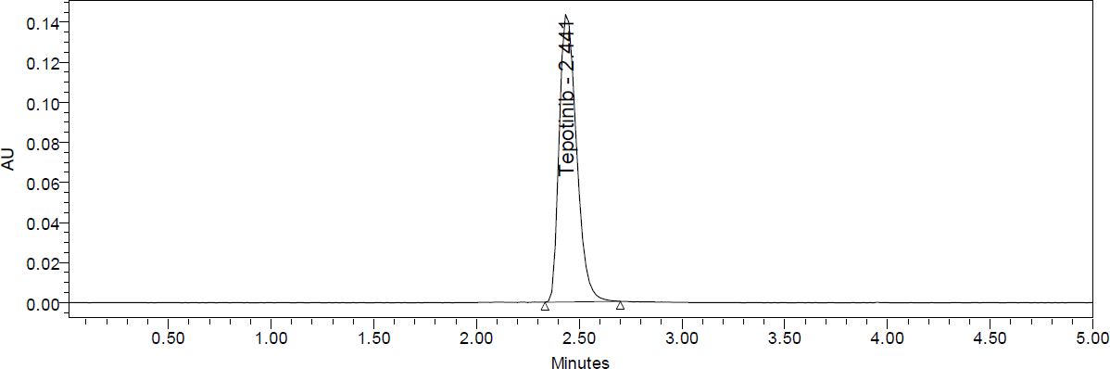
Optimized chromatographic condition
Mobile phase : Methanol: 0.1% orthophosphoric acid (70:30)
Flow rate : 1.0 mL/min
Column used : Kromosil C₁₈ 250mm x 4.6mm, 5µ
Injection vol : 10 µL
Observation: All the system suitability parameters were within the range & satisfactory as per ICH guidelines.

Slide 18
RESULT AND DISCUSSION
ASSAY OF MARKETED FORMULATION
Standard solution and sample solution were injected separately into the system and chromatograms were recorded and drug present in sample was calculated using before mentioned formula. And chromatogram was shown in (Fig. 6.28, 6.29)
Assay of Formulation
Sample No | %Assay
1 | 99.9
2 | 99.9
3. | 101.2
4. | 99.9
5. | 100.1
6. | 99.9
AVG | 100.15
STDEV | 0.51
%RSD | 0.5

Slide 19
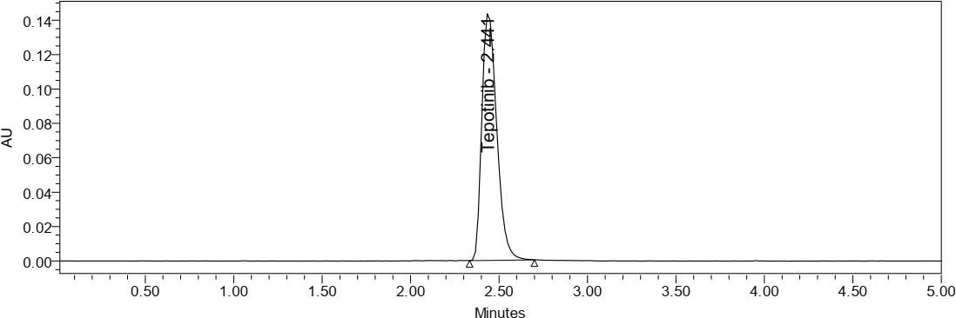
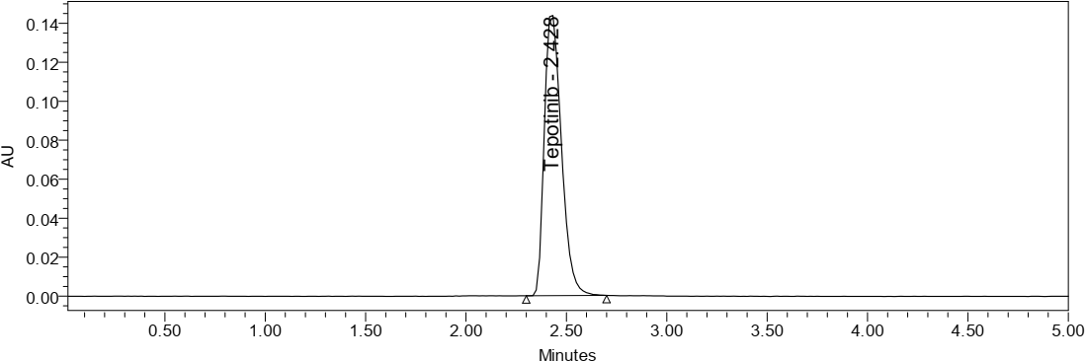
Standard chromatogram
Sample chromatogram

Slide 20
SYSTEM SUITABILITY PARAMETERS
A Standard solution of Tepotinib working standard was prepared as per procedure and was injected five times into the HPLC system. The system suitability parameters were evaluated from standard Chromatograms obtained by calculating the % RSD of retention time, tailing factor, theoretical plates and peak areas from five replicate injections are within range.
S NO | TEPOTINIB
Inj | RT (min) | USP Plate Count | Tailing
1 | 2.43 | 4027 | 1.29
2 | 2.431 | 4022 | 1.29
3 | 2.432 | 4136 | 1.28
4 | 2.435 | 4204 | 1.28
5 | 2.439 | 3909 | 1.33
6 | 2.441 | 4005 | 1.32

Slide 21
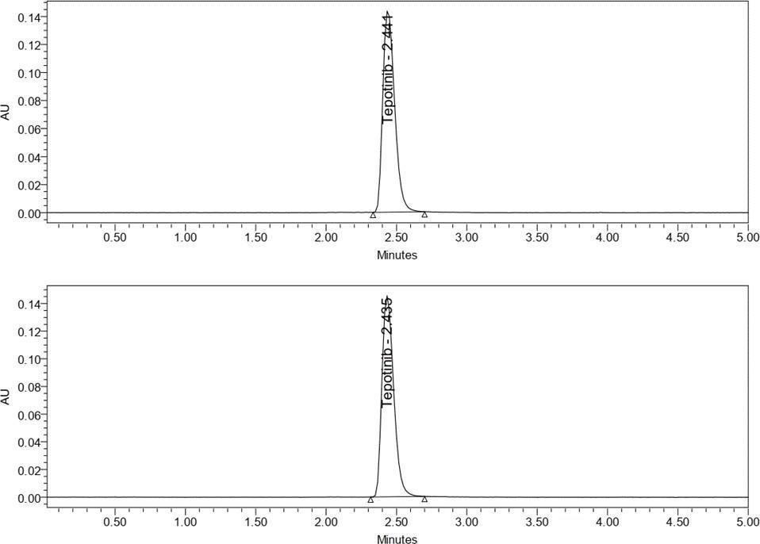
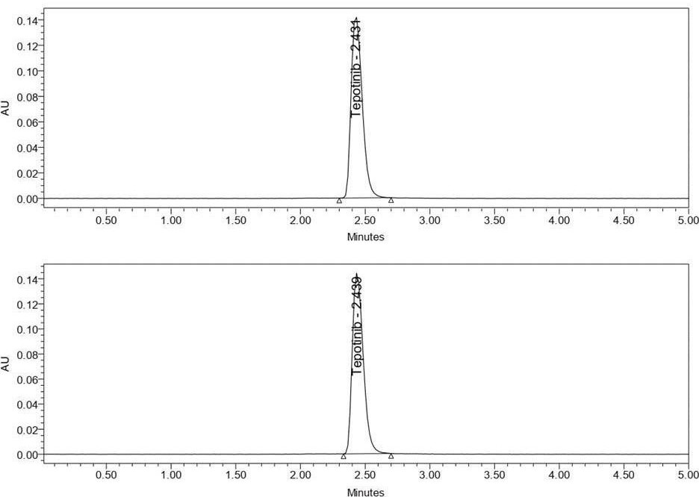
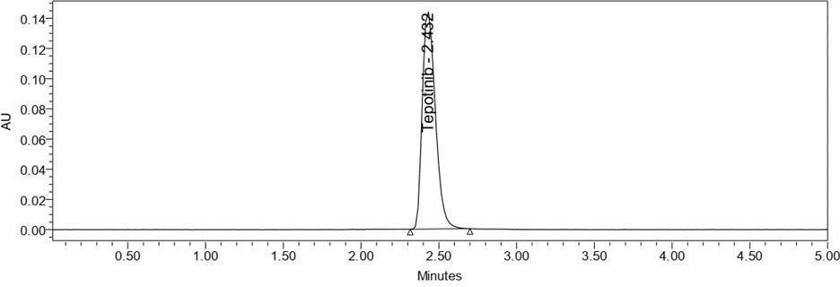

System suitability chromatograms

Slide 22
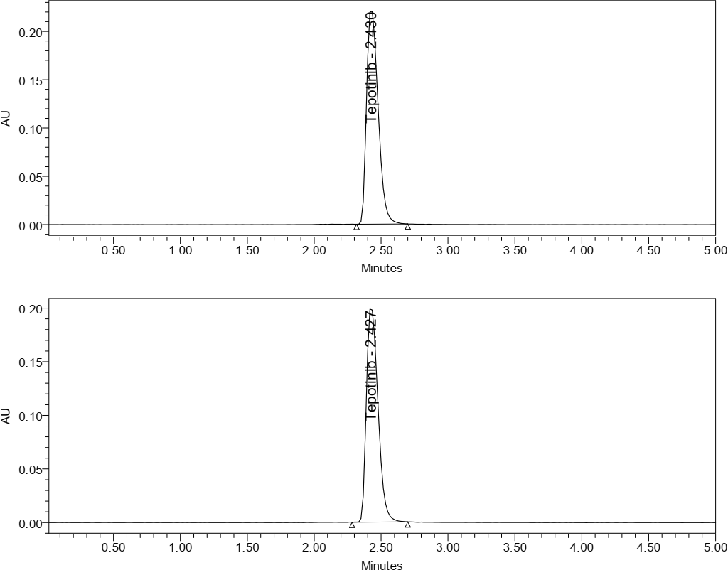
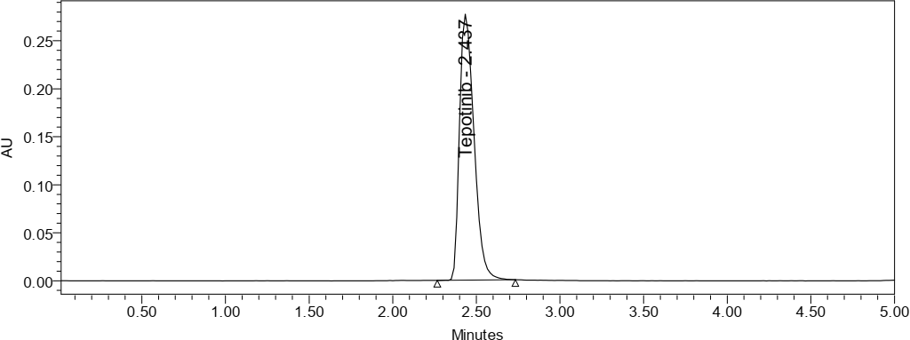
ACCURACY
Three Concentrations of 50%, 100%, 150% are Injected in a triplicate manner and % Recovery was calculated as 100.25%.
Accuracy 50% chromatogram
Accuracy 100% chromatogram

Slide 23
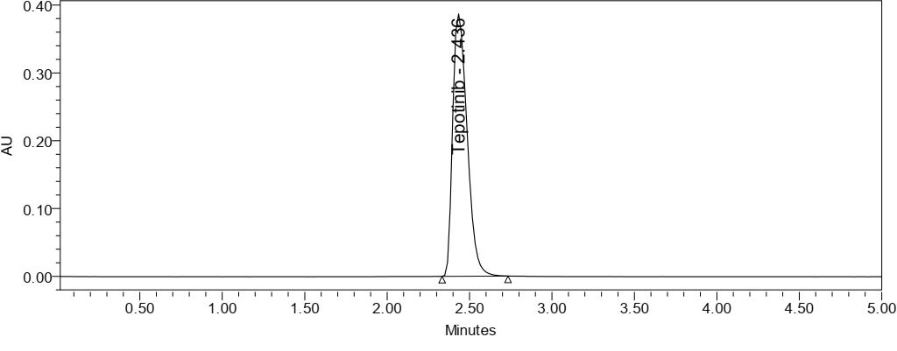
Accuracy 150%chromatogram
% level | Amount spiked (µg /ml) | Amount recovered(µg/mL) | %Recovery | Mean % Recovery
50% | 22.5 | 22.779 | 101.24 | 100.25
100% | 45 | 44.509 | 98.91
150% | 67 | 66.681 | 99.52
Accuracy data

Slide 24
PRECISION
Repeatability: Six working sample solutions are injected and the % Amount found was calculated and %RSD was found to be 0.2
Repeatability data for tepotinib
S.NO | Peak Area
1 | 946274
2 | 946451
3 | 958451
4 | 946271
5 | 948534
6 | 946392
AVG | 948729
STDEV | 4843.0
%RSD | 0.5

Slide 25
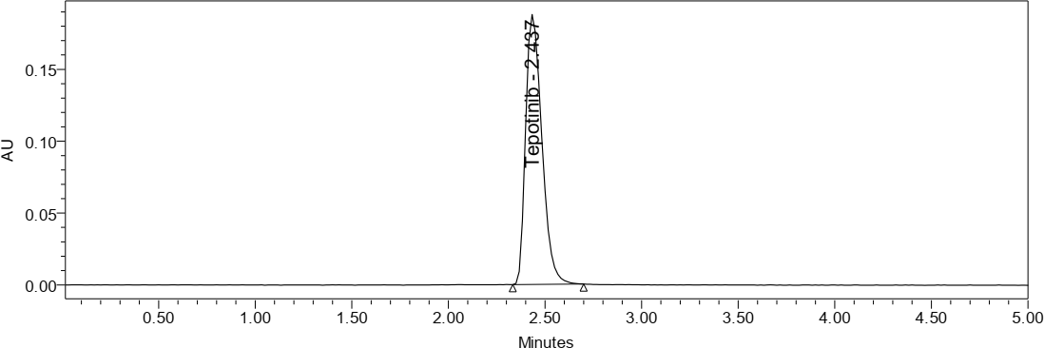
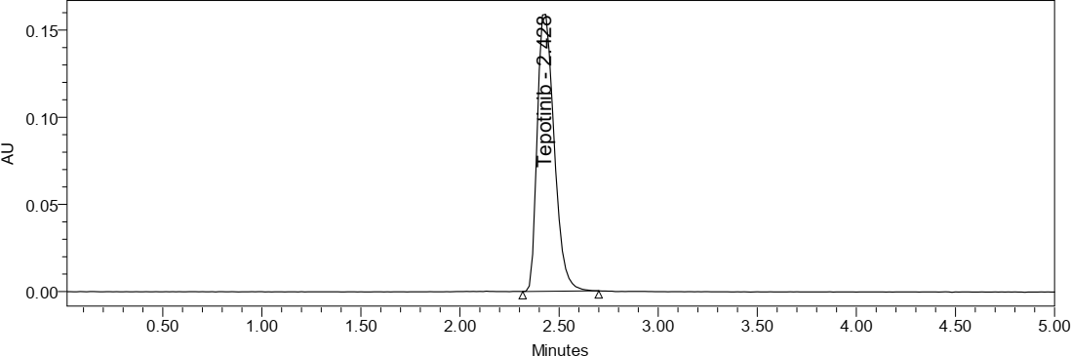
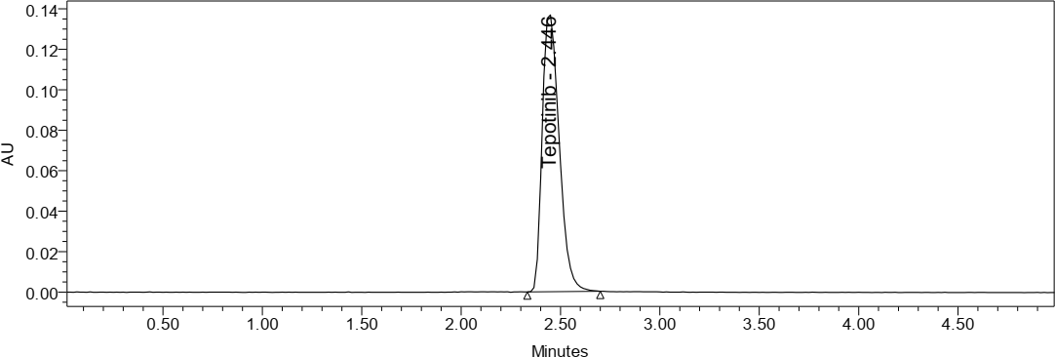
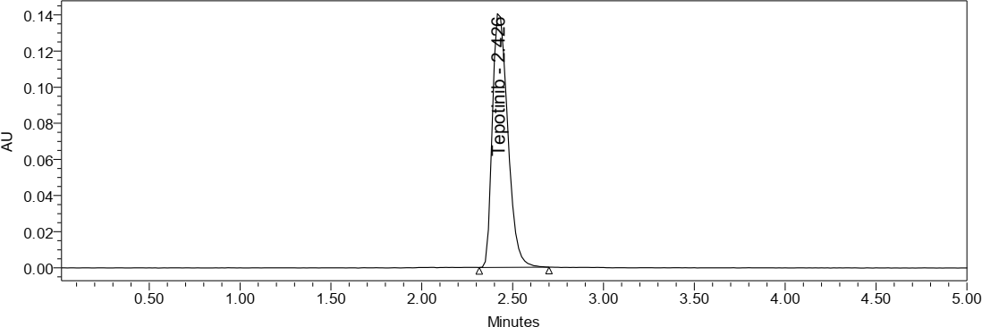
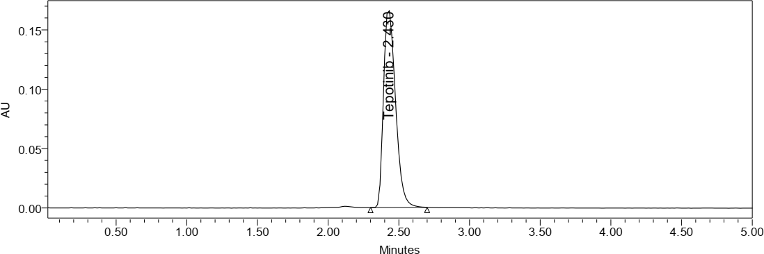
Repeatability Chromatogram

Slide 26
INTERMEDIATE PRECISION:
six working sample solutions are injected on the next day of the preparation of samples and the % Amount found was calculated and %RSD was found to be 0.6.
Intermediate precision data
S. No | Peak Area
1 | 908201
2 | 909522
3 | 903452
4 | 904407
5 | 907175
6 | 913312
AVG | 907678
STD EV | 3584.1
%RSD | 0.4

Slide 27



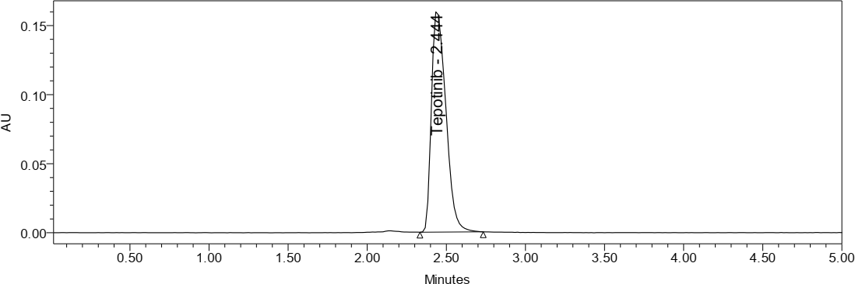
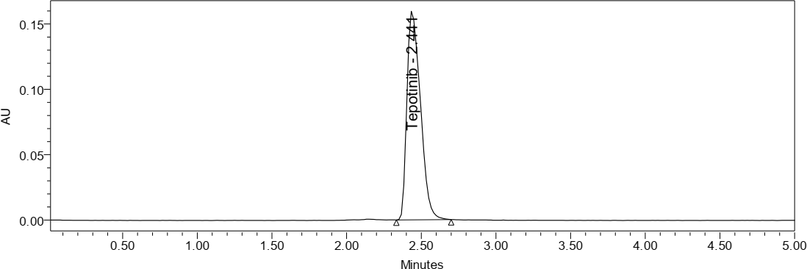
Intermediate precision chromatogram

Slide 28
LINEARITY:
To demonstrate the linearity of assay method, inject 6 standard solutions with concentrations of about 5 ppm to 30 ppm of Tepotinib. Plot a graph to concentration versus peak area. Slope obtained was 46421 Y-Intercept was 1052 and Correlation Co-efficient was found to be 0.999.
Linearity Concentration and Response
Linearity Level (%) | Concentration (ppm) | Area
0 | 0 | 0
25 | 11.25 | 234558
50 | 22.5 | 467396
75 | 33.75 | 692740
100 | 45 | 927364
125 | 56.25 | 1125501
150 | 67 | 1333315

Slide 29
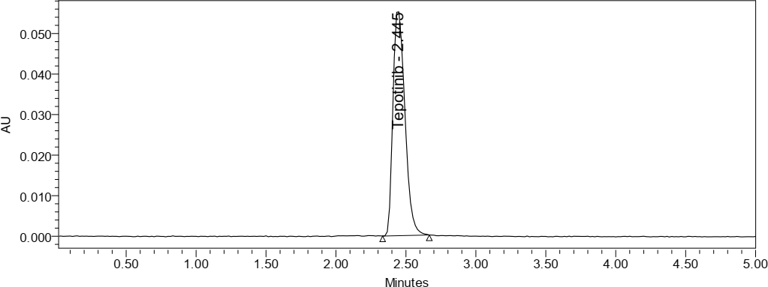
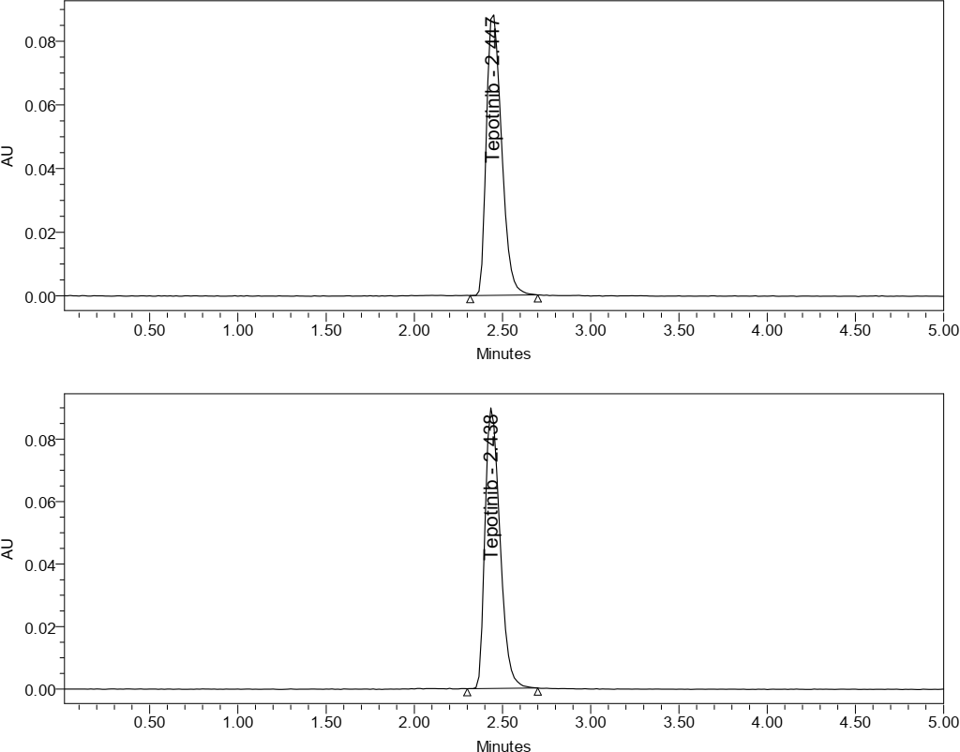
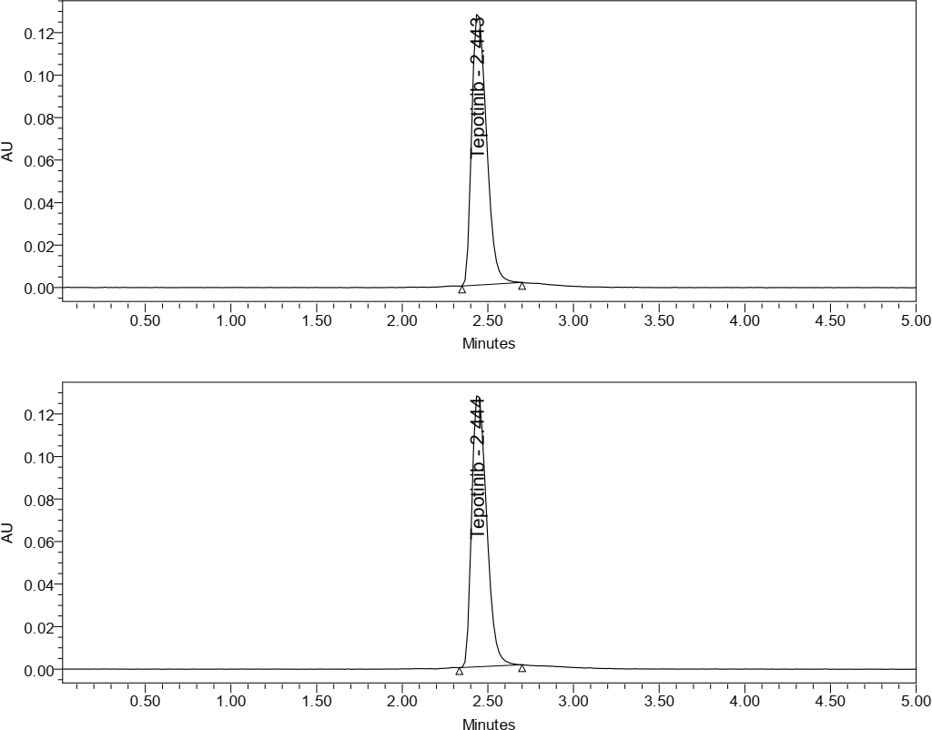
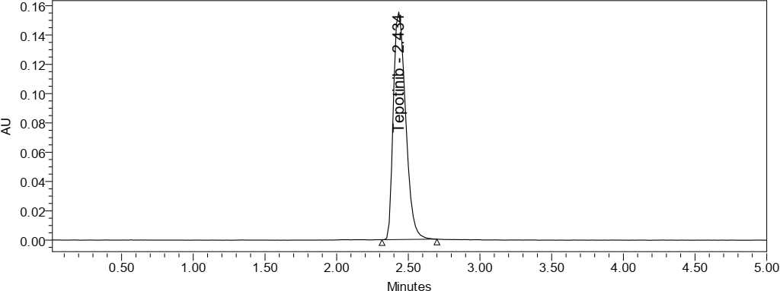
Linearity 25% chromatogram
Linearity 50% chromatogram
Linearity 75% chromatogram
Linearity 100% chromatogram

Slide 30


Linearity 125% chromatogram
Linearity 150% chromatogram
AVG
1600000
1400000
1200000
1000000
800000
600000
400000
200000
0
y = 19912x + 12377
R² = 0.9994
AVG
Linear (AVG)
0 20 40 60 80
Linearity plot

Slide 31
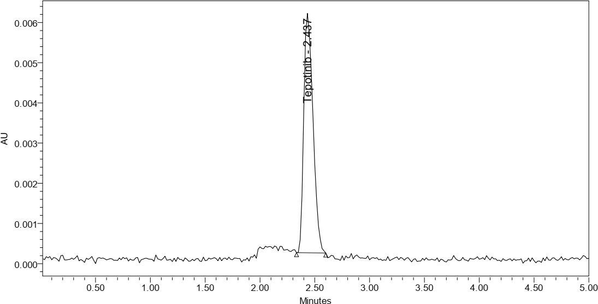
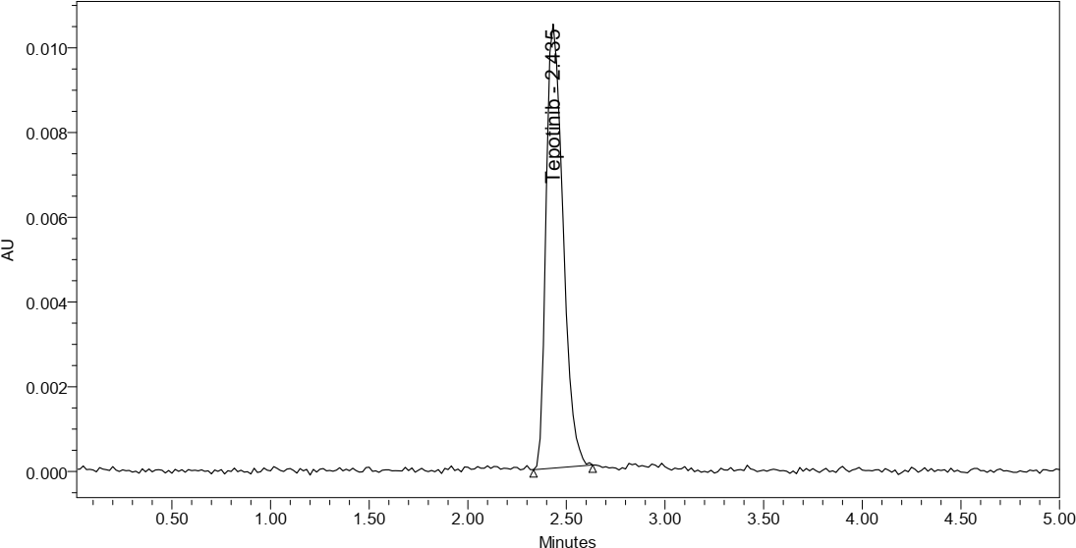
LOD: Detection limit of the Tepotinib in this method was found to be 0.21 µg/mL.
LOQ: Quantification limit of the Tepotinib in this method was found to be 0.63µg/mL
LOD chromatogram of tepotinib
LOQ chromatogram of tepotinib

Slide 32
ROBUSTNES
Small Deliberate change in the method is made like Flow minus, flow plus, Mobile phase minus, Mobile phase plus, Temperature minus, Temperature Plus. %RSD of the above conditions is calculated.
Robustness Data
Parameter | %RSD
Flow Minus | 0.2
Flow Plus | 0.5
Mobile phase Minus | 0.3
Mobile phase Plus | 0.4
Temperature minus | 0.3
Temperature plus | 0.4

Slide 33
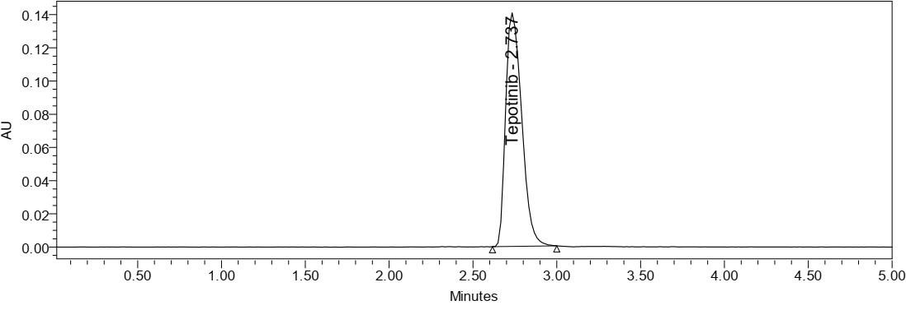
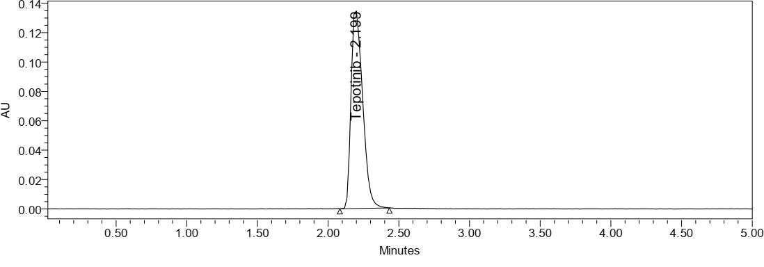
Flow minus chromatogram of tepotinib
Flow plus chromatogram of tepotinib

Slide 34
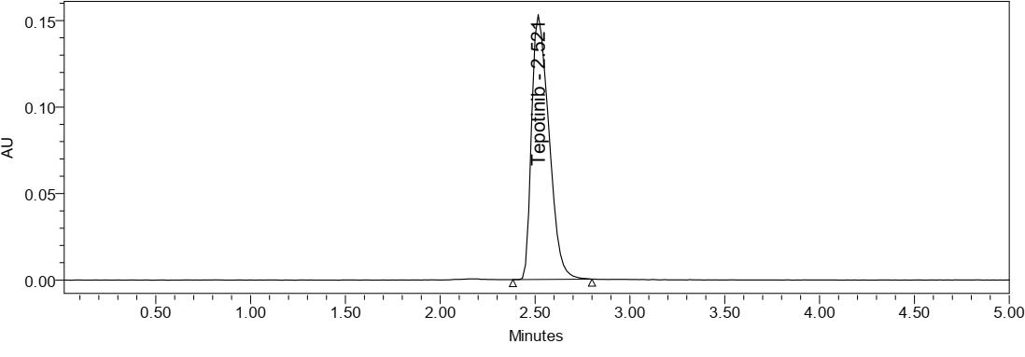
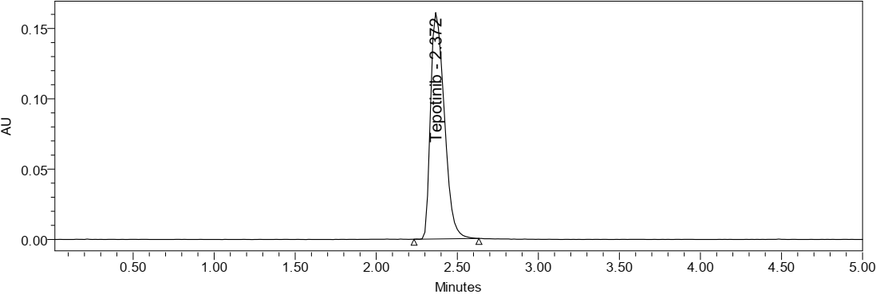
Mobile phase minus chromatogram of tepotinib
Mobile phase plus chromatogram of tepotinib

Slide 35
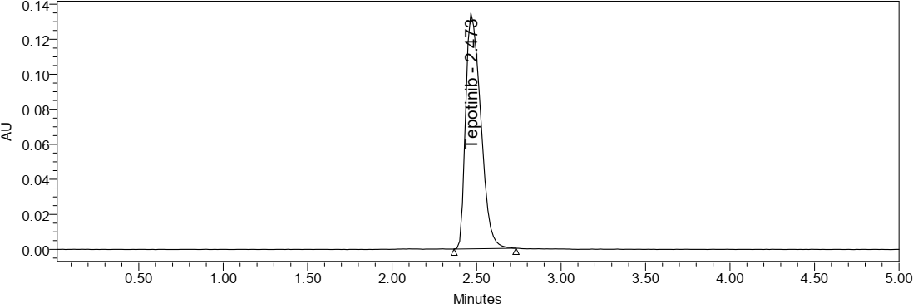
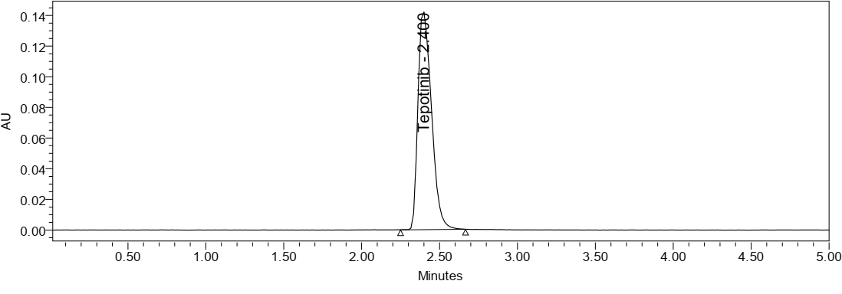
Temperature minus chromatogram of tepotinib
Temperature plus chromatogram of tepotinib

Slide 36
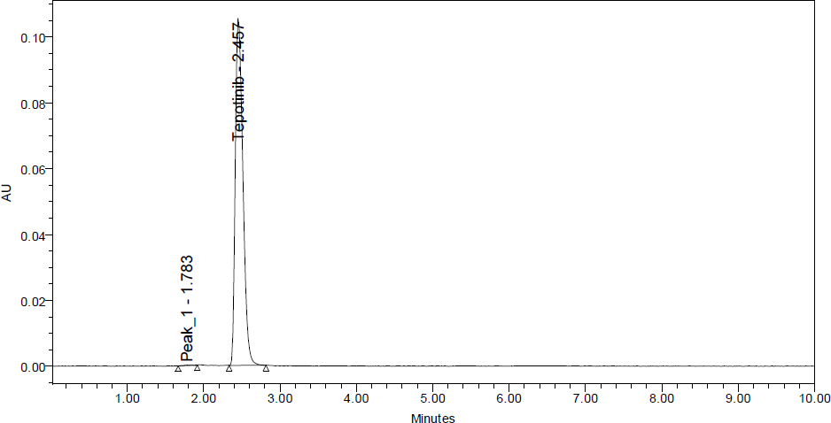
DEGRADATION STUDIES
Acid Degradation Studies
To 1 mL of stock solution Tepotinib 1 mL of 2N Hydrochloric acid was added and refluxed for 30mins. The resultant solution was diluted to obtain (45 ppm) solution and 10 µL solutions were injected into the system and the chromatograms were recorded to assess the stability of sample.
 | Peak Name | RT | Area | Purity1 Angle | Purity1 Threshold | USP Plate Count | USP Tailing | USP Resolution
1 | Peak_1 | 1.783 | 1171 | 11.516 | 8.899 | 74000 | 1.1
2 | Tepotinib | 2.457 | 871398 | 0.238 | 0.316 | 2861 | 1.3 | 6.4

Slide 37
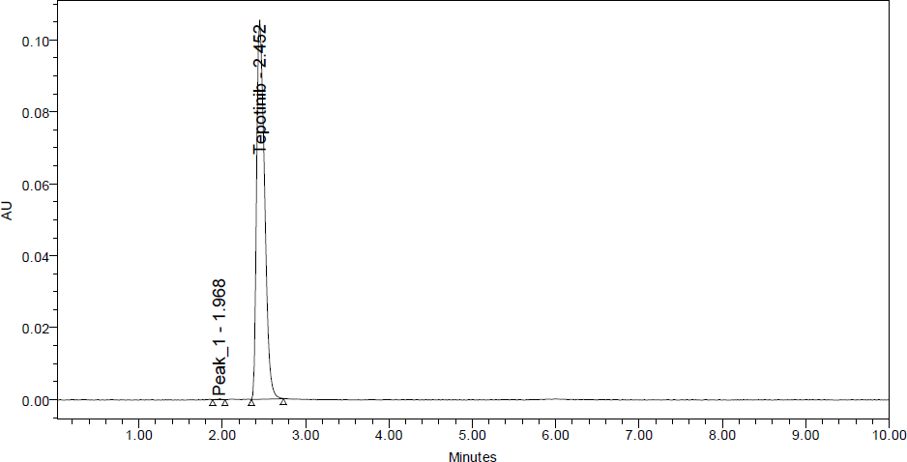
Base Degradation Studies
To 1 mL of stock solution Tepotinib 1 mL of 2 N sodium hydroxide was added and refluxed for 30 mins. The resultant solution was diluted to obtain (45ppm) solution and 10 µL were injected into the system and the chromatograms were recorded to assess the stability of sample.
 | Peak Name | RT | Area | Purity1 Angle | Purity1 Threshold | USP Plate Count | USP Tailing | USP Resolution
1 | Peak_1 | 1.968 | 620 |  |  | 7879 | 1.0
2 | Tepotinib | 2.452 | 891302 | 0.227 | 0.280 | 3132 | 1.4 | 3.6

Slide 38
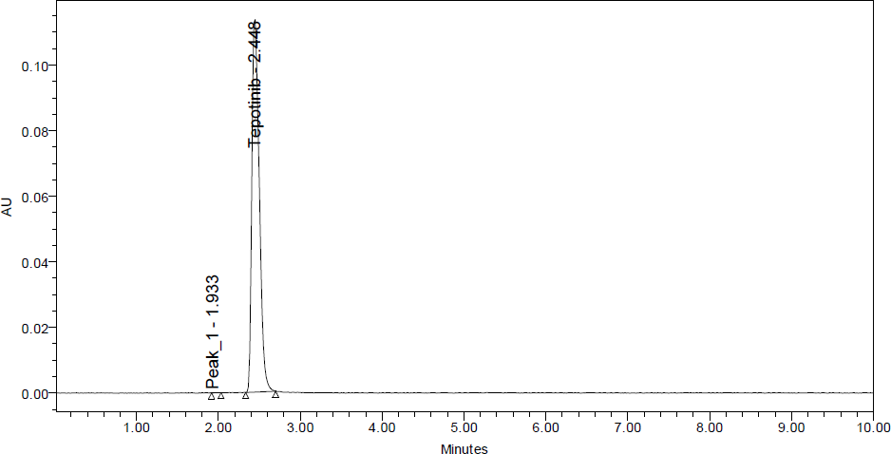
Peroxide degradation studies
To 1 mL of stock solution of Tepotinib 1 mL of 20% hydrogen peroxide (H₂O₂) was added separately. The solutions were kept for 30 min at . For HPLC study, the resultant solution was diluted to obtain (45 ppm) solution and 10 µL were injected into the system and the chromatograms were recorded to assess the stability of sample.
 | Peak Name | RT | Area | Purity1 Angle | Purity1 Threshold | USP Plate Count | USP Tailing
1 | Peak_1 | 1.933 | 281 |  |  |  | 1.4
2 | Tepotinib | 2.448 | 915131 | 0.217 | 0.282 | 3436 | 1.4

Slide 39
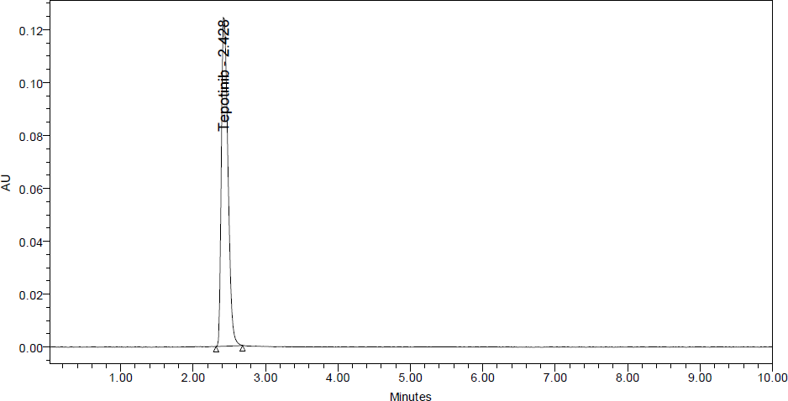
Thermal Degradation Studies
The standard drug solution was placed in oven at 105℃ for 6 h to study dry heat degradation. For HPLC study, the resultant solution was diluted to (45 ppm) solution and10 µL were injected into the system and the chromatograms were recorded to assess the stability of the sample.
 | Peak Name | RT | Area | Purity1 Angle | Purity1 Threshold | USP Plate Count | USP Tailing
1 | Tepotinib | 2.428 | 932178 | 0.202 | 0.273 | 3444 | 1.4

Slide 40

UV- degradation studies
The photochemical stability of the drug was also studied by exposing the (450 ppm) solution to UV Light by keeping the beaker in UV Chamber for 7days or 200-Watt hours/m² in photo stability chamber. For HPLC study, the resultant solution was diluted to obtain (45 ppm) solutions and 10 µL were injected into the system and the chromatograms were recorded to assess the stability of sample.
 | Peak Name | RT | Area | Purity1 Angle | Purity1 Threshold | USP Plate Count | USP Tailing
1 | Tepotinib | 2.428 | 935281 | 0.208 | 0.271 | 3404 | 1.4

Slide 41

Water Degradation Studies
Stress testing under neutral conditions was studied by refluxing the drug in water for 6hr s at a temperature of 60ºc. For HPLC study, the resultant solution was diluted to (45 ppm) solution and 10 µL were injected into the system and the chromatograms were recorded to assess the stability of the sample.
 | Peak Name | RT | Area | Purity1 Angle | Purity1 Threshold | USP Plate Count | USP Tailing
1 | Tepotinib | 2.427 | 942138 | 0.206 | 0.281 | 3421 | 1.4

Slide 42
Degradation Data of Tepotinib
S.NO | Degradation Condition | %Drug Un Degraded | %Drug Degraded
1 | Acid | 91.98 | 8.02
2 | Alkali | 94.08 | 5.92
3 | Oxidation | 96.60 | 3.40
4 | Thermal | 98.40 | 1.60
5 | UV | 98.73 | 1.27
6 | Water | 99.45 | 0.55

Slide 43
SUMMARY AND CONCLUSION
Parameters |  | Tepotinib | Limit
Linearity: Range (µg/mL) |  | 11.25-67µg/mL | R< 1
Regression coefficient |  | 0.999
Slope(m) |  | 19912
Intercept(c) |  | 12377
Regression equation (Y= mx+c) |  | y = 19912x + 12377
Assay (% mean assay) |  | 100.15% | 90-110%
Specificity |  | Specific | No interference of any peak
System precision %RSD |  | 0.4 | NMT 2.0%
Method precision %RSD |  | 0.5 | NMT 2.0%
Accuracy %recovery |  | 100.25% | 98-102%
LOD |  | 0.21 | NMT 3
LOQ |  | 0.63 | NMT 10
Robustness | FM | 0.2 | %RSD NMT 2.0
 | FP | 0.5
 | MM | 0.3
 | MP | 0.4
 | TM | 0.3
 | TP | 0.4

